Slide 1
Plastic Turtle
East Coast Gang

Slide 2
Quick Recap
Keep the Ocean Clean, Save the Turtles.
Target Group: 14+
The game is about a baby turtle that has to survive the trash from the ocean. You start out in the clean ocean water, minding your own business and growing up. As soon as you reach adolescence the ocean begins to become riddled with trash, not much but it slowly becomes abundant. At adult-hood you live to see your once beautiful home, become a festering place for disease, trash everywhere, water is green. You become stuck and you die.
https://www.seeturtles.org/help-save-turtles

Slide 3
Keep the Ocean Clean, save the Turtles
An endless runner game that shows the player, the life of a turtle, from it being a hatchling to it being a full grown adult.
The main gimmick of the game is to keep the turtle alive by constantly avoiding the trash while eating the food, keeping track of the health and food bar.
As time passes the game will get gradually harder in the means of there being less food and more and more trash. The background scene will change as the player progresses showing how the ocean was really affected by the lack of interest from the people.
To keep track of progress, the game will include a time-tracker that shows the player how much he has gone in age from the beginning. This tracker will help the player remember where he has finished his last run.

Slide 4
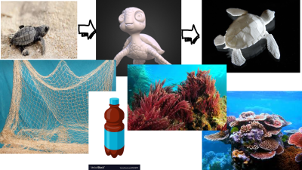
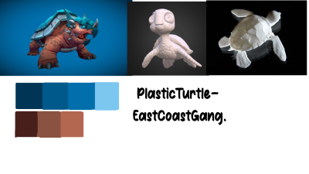
Ideation: Style
MoodBoard
StyleSheet

Slide 5
1. Programming

Slide 6
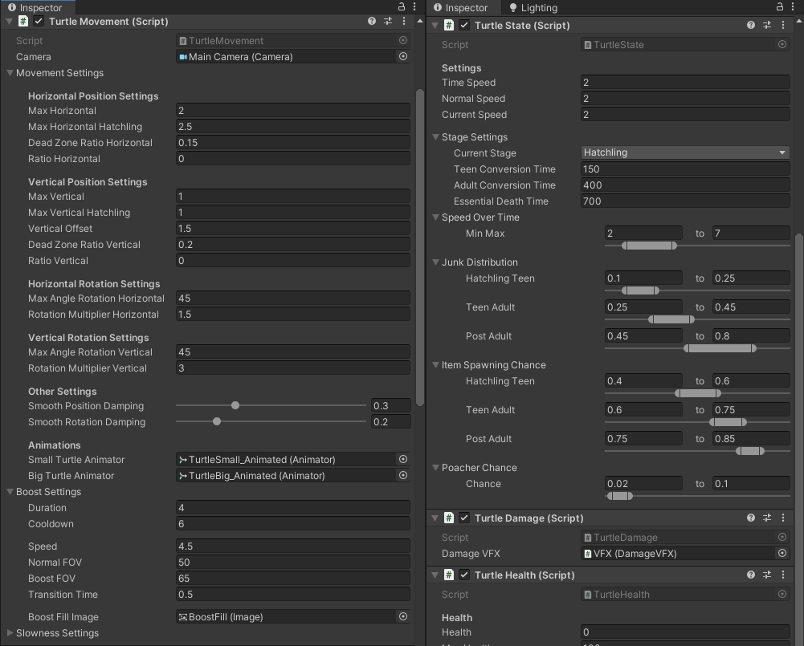
Scripts are set up in a user-friendly way for designers/artists.
Custom property drawers
Dropdowns for relevant sections of scripts
Use of C# attributes to change how the inspector is drawn
Scripts are placed on objects in an intuitive way.

Slide 7
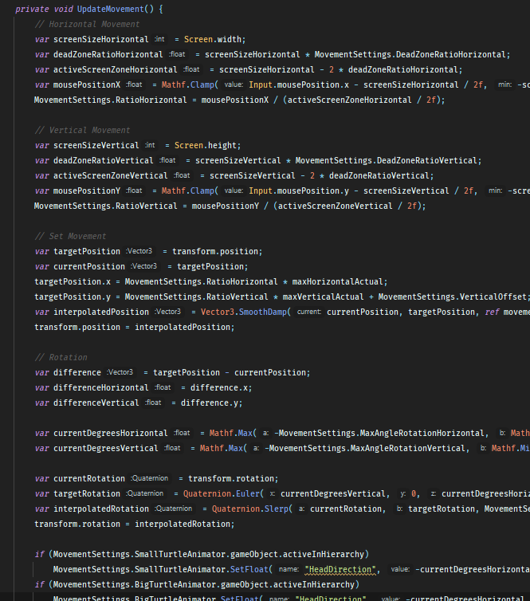
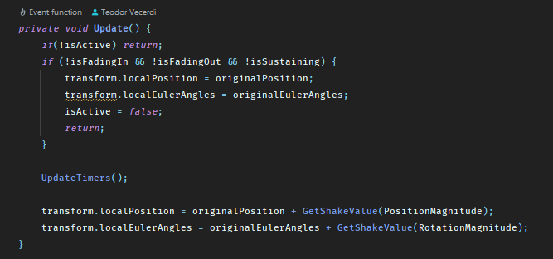
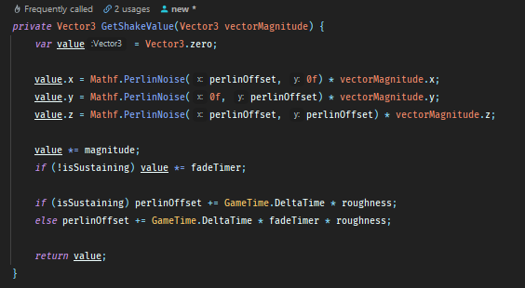
Complex interactions
Procedural turtle animations based on input and movement
Camera shaking, FOV change based on speed

Slide 8

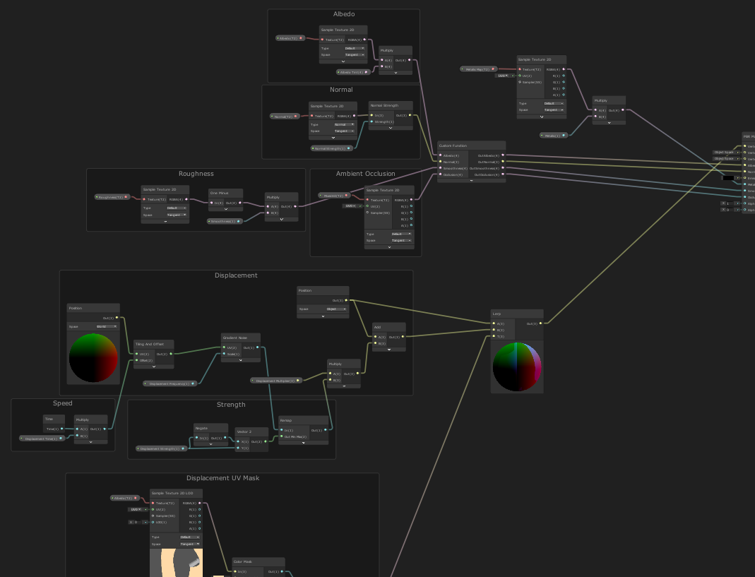
Advanced Features
Custom shaders & subshaders
Vertex displacement shaders to achieve the underwater look & feel

Slide 9
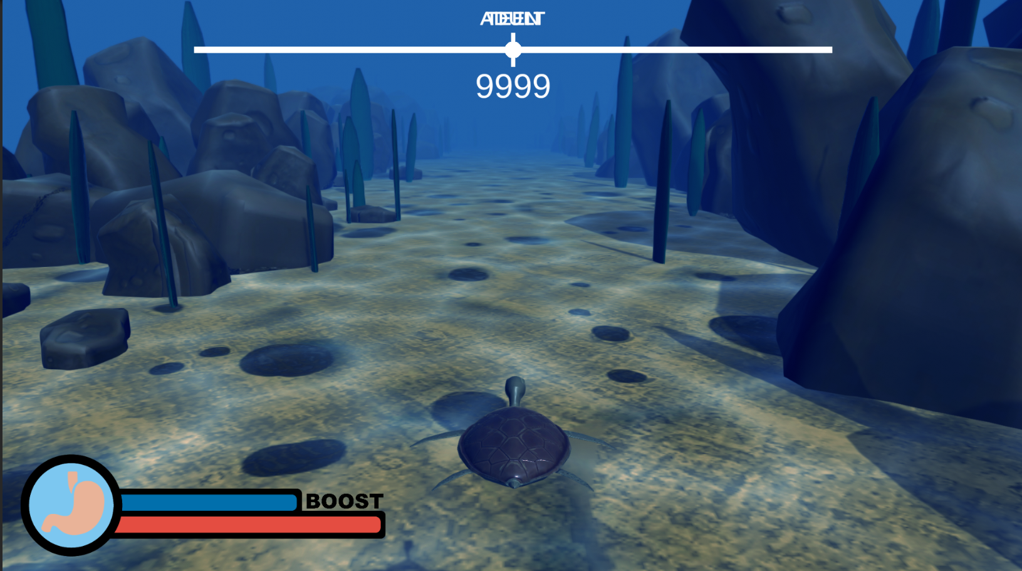
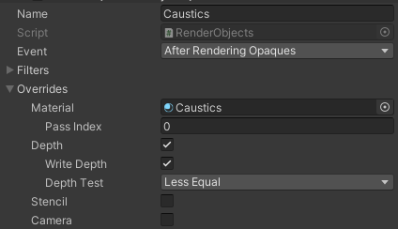
Advanced Features
Custom renderer feature to overlay the water ripples/caustics shader on top of all the objects

Slide 10
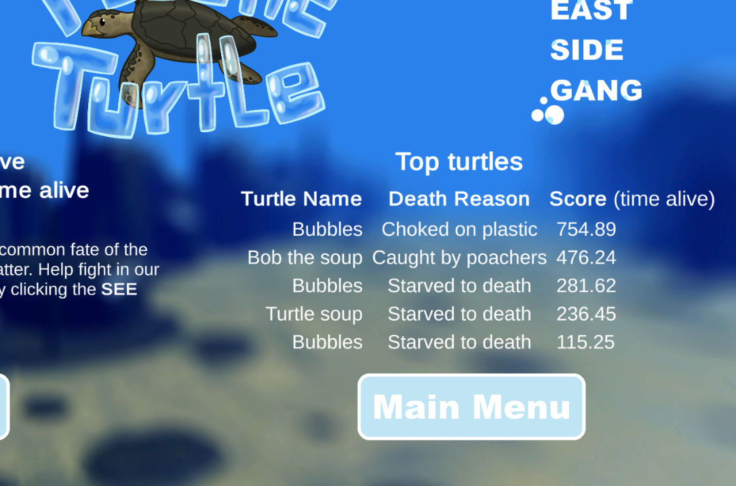
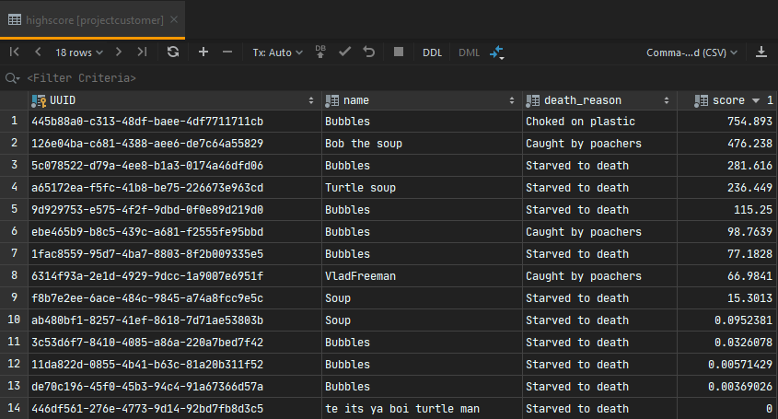
Advanced Features
Leaderboard keeping track of the best players

Slide 11
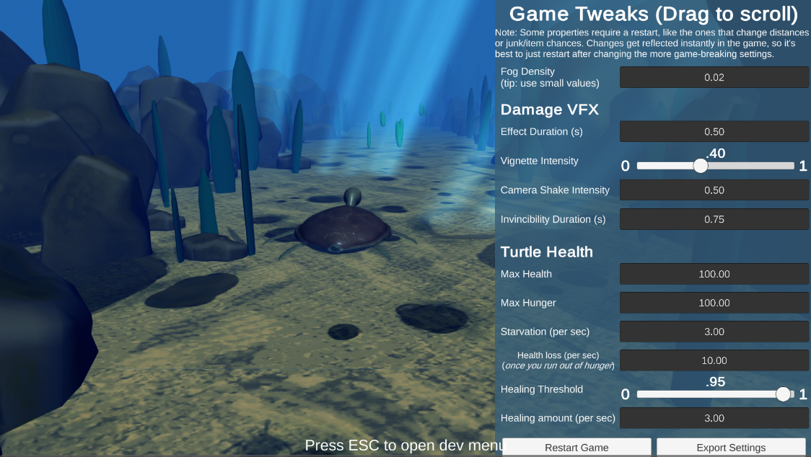
Advanced Features
Built-in dev tools/cheats to allow for fast testing and iteration.

Slide 12
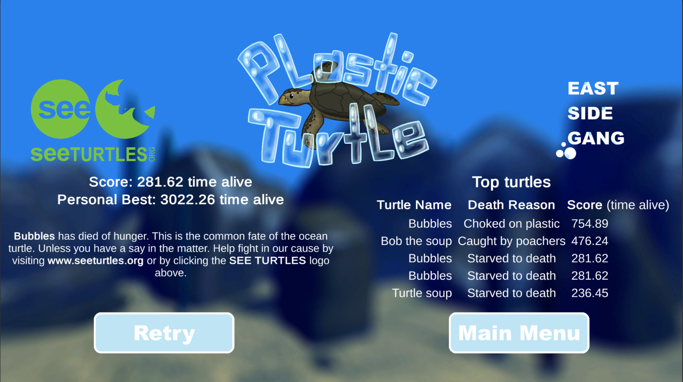
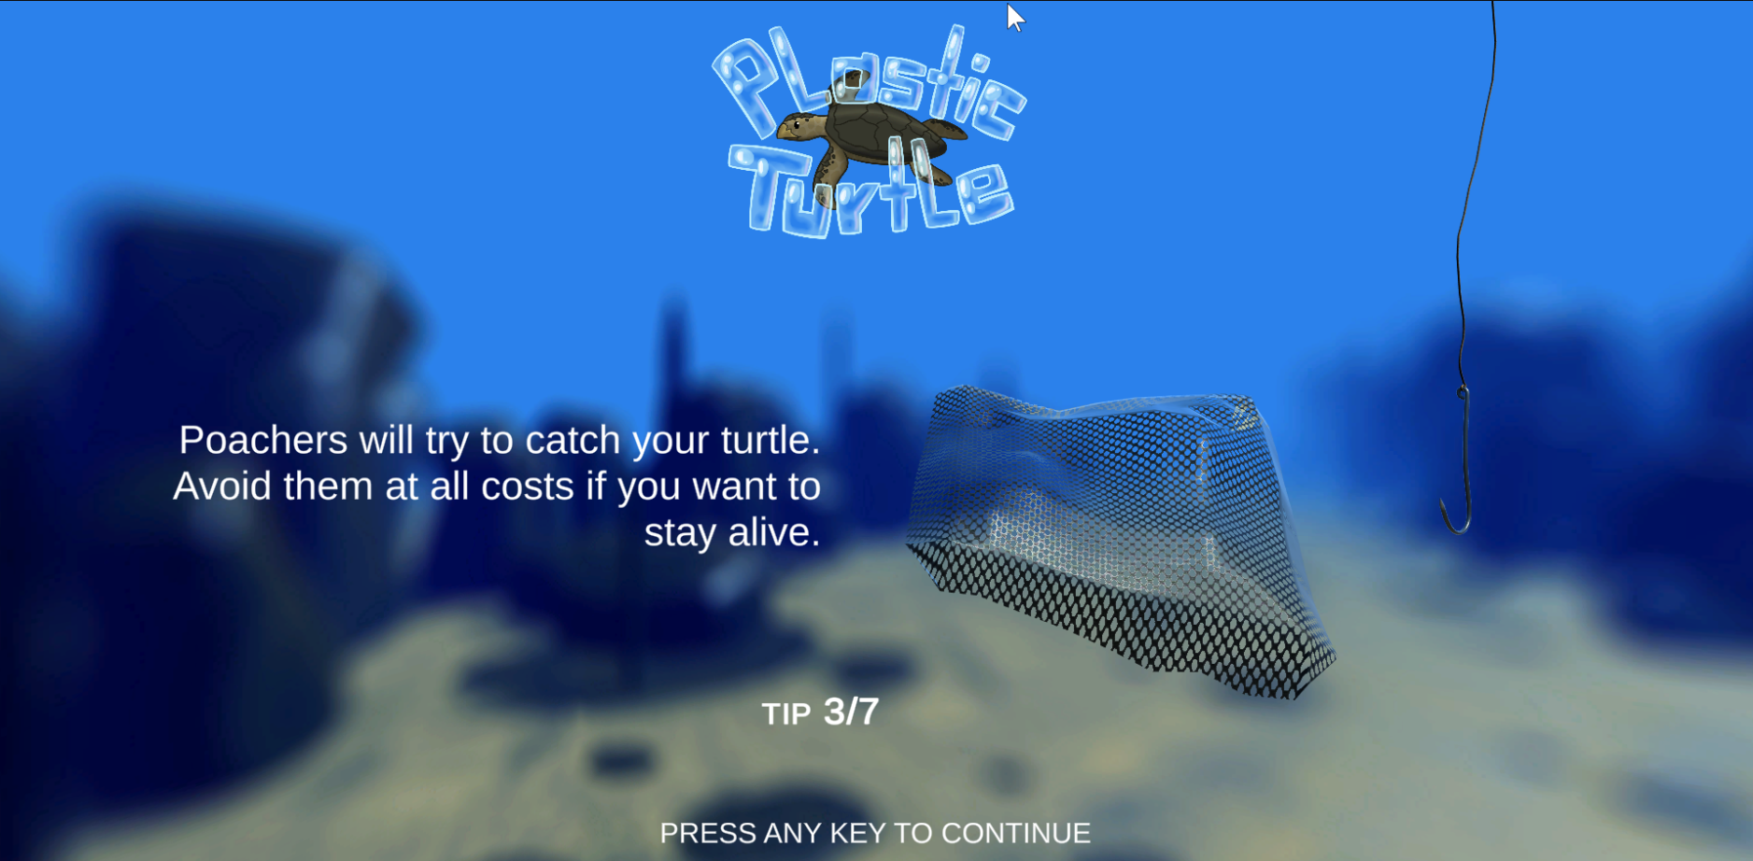
UX and UI
For the game:
Easy natural navigation trough the menus, clear buttons.
Buttons that give visual feedback when hovered.
Leaderboard, Names, Scrolling background

Slide 13
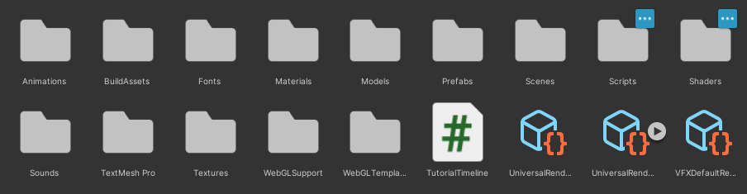

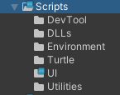
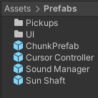
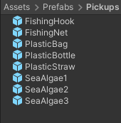
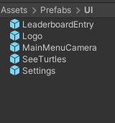
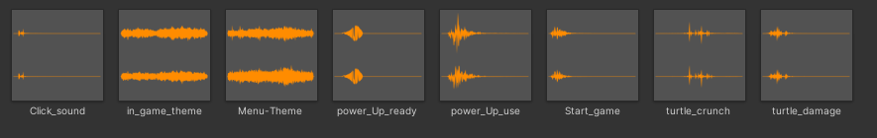
Content & Art
- Good and organized folder structure
- Use of prefabs where relevant
- High quality and varied audio / music
- Optimized assets:
- The 3D models combined take up 4MB, even before being imported and optimized further by Unity
- Sounds are 5.7MB and 5.6MB of that are just the two music tracks
- 1024x1024 textures, compressed in Unity

Slide 14
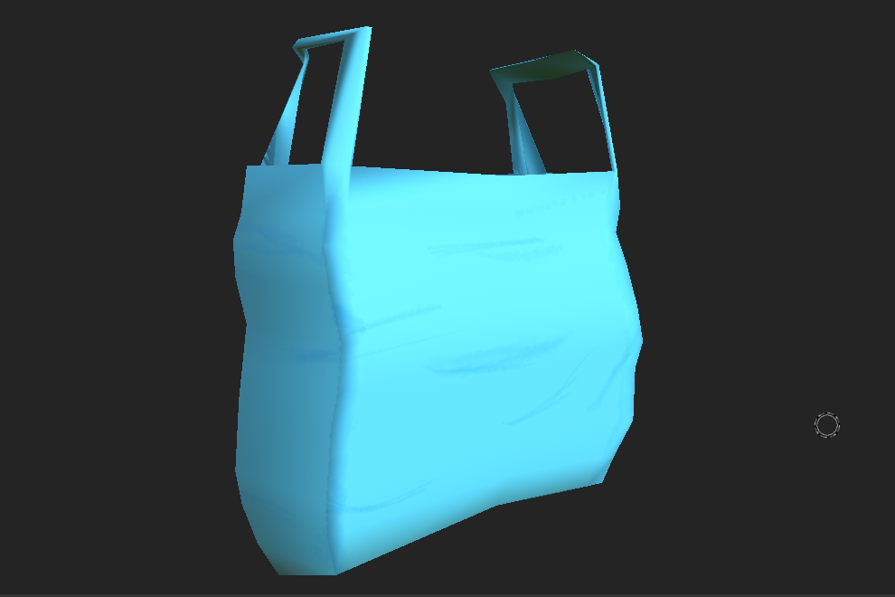
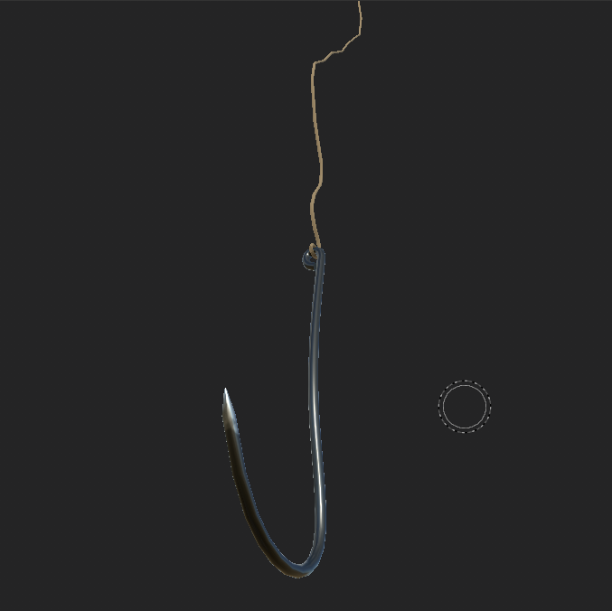
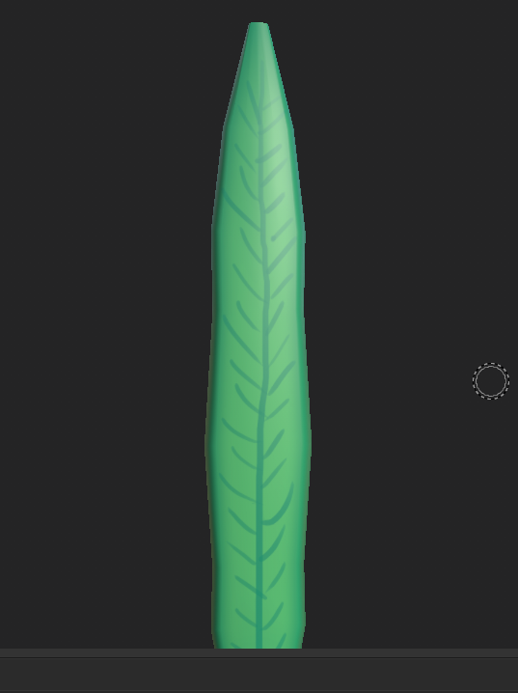
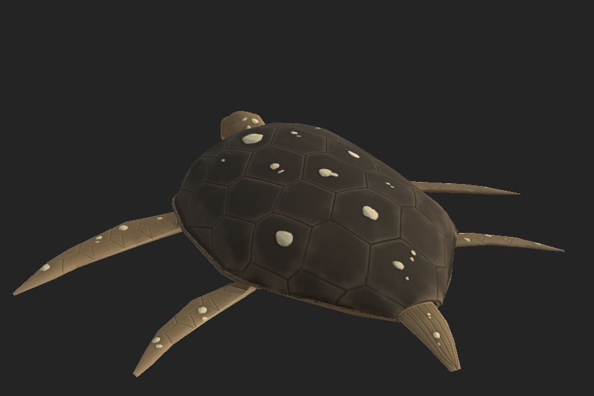
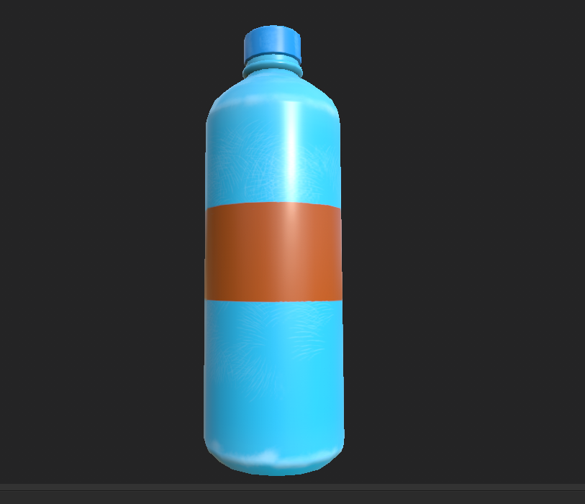

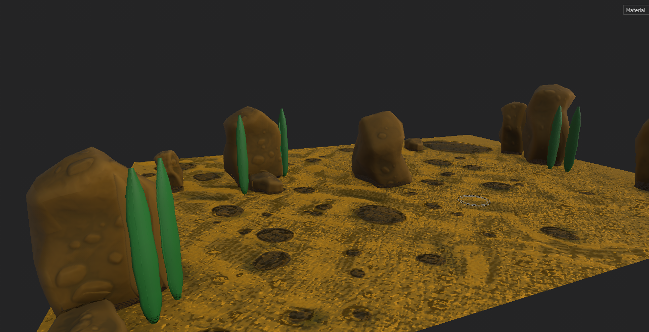
In Game Art:

Slide 15
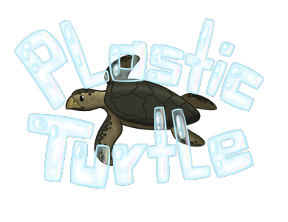




Artist: The In-Game Art for Menus, buttons.

Slide 16
Concept & Narrative
The concept of the trailer
Is that it starts with the story of the hatchling
And continues with the gameplay scenes.
I used some green screen effects + transition effects and allot of SFX.
Wanted to portray the feeling of survival in the trailer.

Slide 17
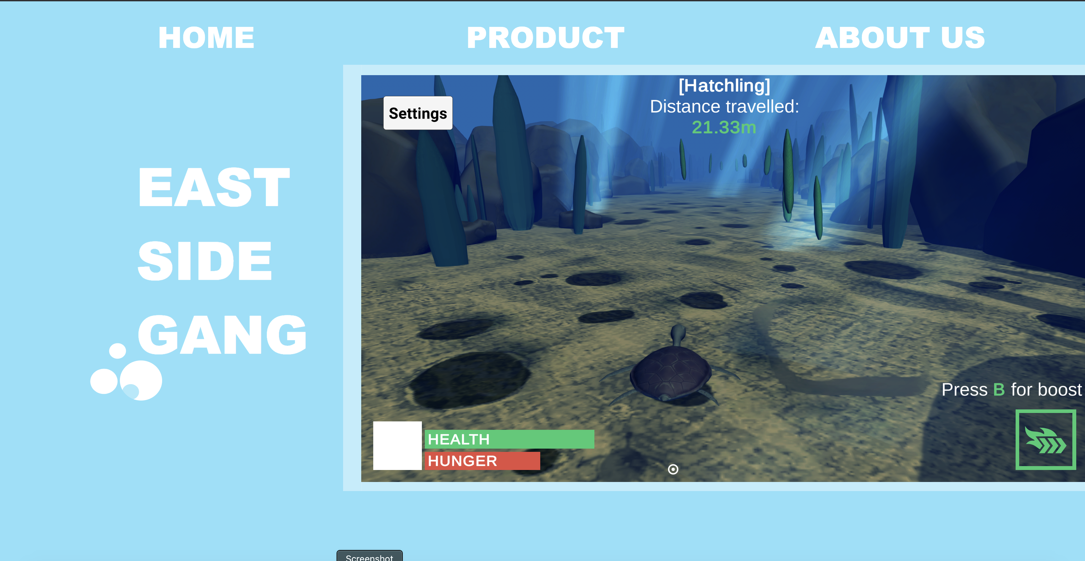
Designers: Website
New DESIGN
Implementing IFRAME
Coding CSS animations
Hosting WEBSITE

Slide 18
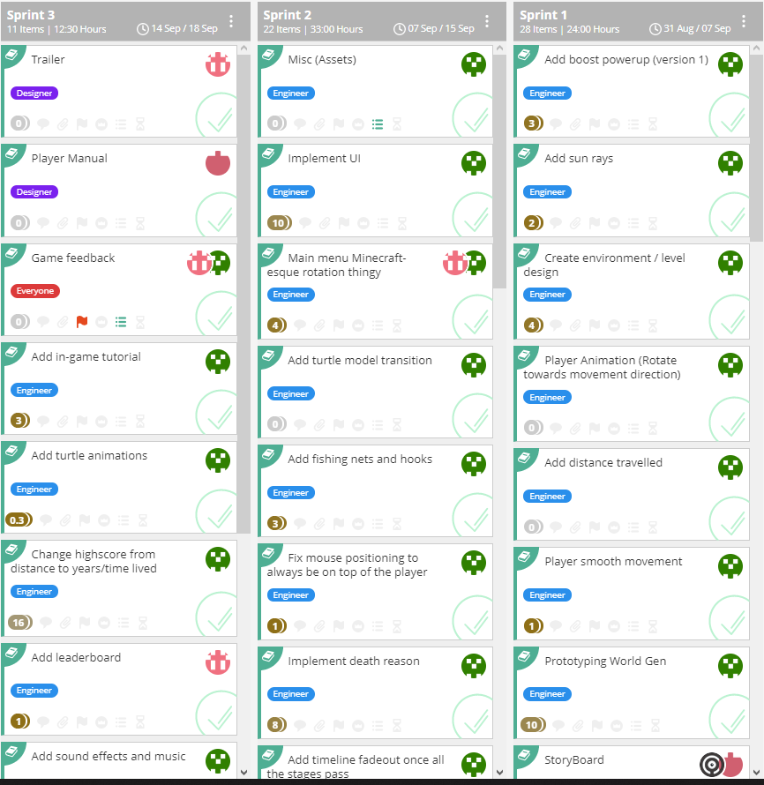
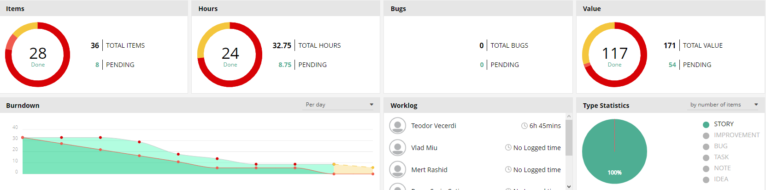
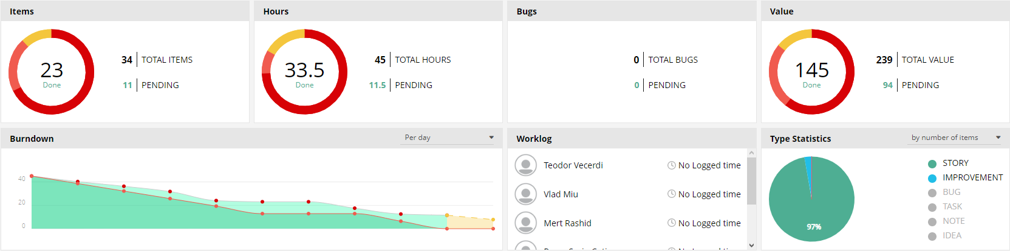
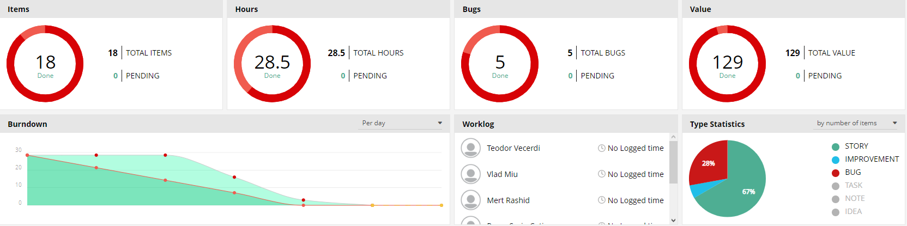
Project Planning & Teamwork
The planning was done on vivify scrum. With burndown charts for the engineering part of the project.

Slide 19
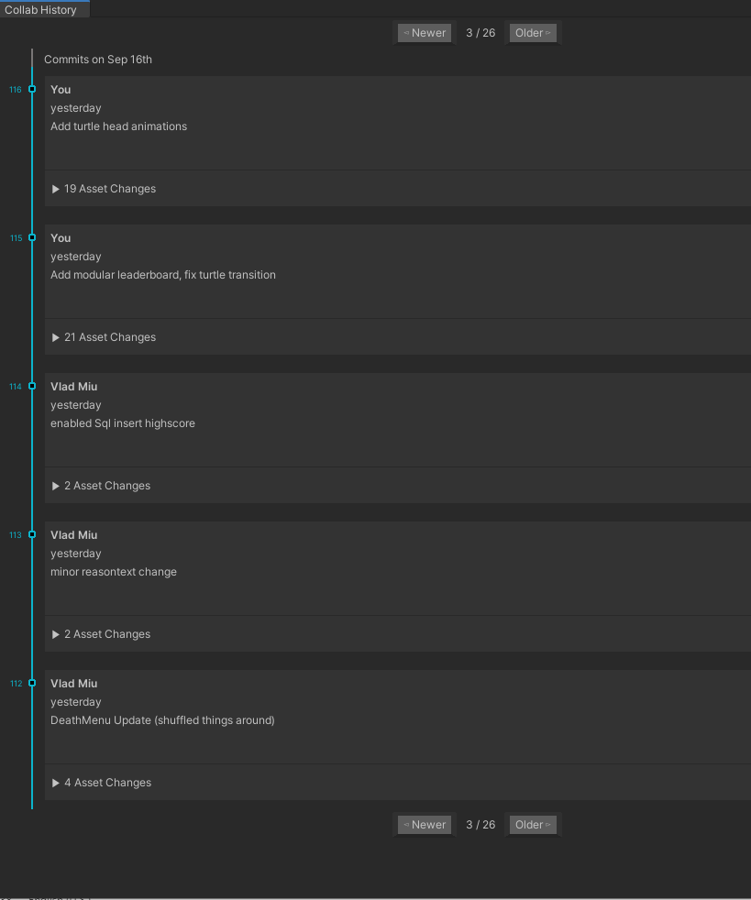
Project Planning & Teamwork
The version control tool is unity collaborate.
The team works in a real professional way. :)

Slide 20
Research & Empathize
Empathy Map:
•Who are we empathizing with?
“Fridays for future” movement. They worry about the future.
They try to raise awareness of the situation, for those who do not know the dire circumstances.
•What do they need to DO
They have to start talking about the situation, showing articles, videos and different kinds of media about this to friends, family and other people.
They want to save the Ocean Wildlife. This can be done by doing the following things. Zero Waste in the Ocean. Employing alternative ways to deal with achieving electricity. Being more mindful of electricity usage.
They have to make conscious decisions regarding the things they buy and how to properly dispose of them. They have to start recycling materials and buying reusable packages, bags, bottles etc.
Time is what is going to acknowledge their success, the majority of the endangered wildlife will become threatened or less. The lack of spillage will be noticeable soon.
•What do they SEE?
They see organizations trying to raise awareness of the situation but to no avail, though with every small donation a part of their work actually happens. They see people littering. Countries buying trash off-shore to satisfy their disposal needs. The different recycling bins having all kinds of trash inside of them, and people not respecting that.

Slide 21
Research & Empathize
Empathy Map:
•What do they SAY?
They encourage people to start recycling, to be wary of their energy consumption, to implement a better, more efficient way of getting their energy which can be renewable.
They might encourage people to stop littering, start buying ecological bags and materials, same with the food.
•What do they DO?
They start to gather the litter off the beaches, in parks and recycle said trash. They are eco- friendly with everything they buy and try to sell, they start businesses that encourage the use of recycled materials. They try to influence other people to stop wasting so much energy
•What do they HEAR?
They hear that people aren’t aware of the situation and continue their lives without a care. Their friends try to help as much as they can. Their second-hand information that they receive is that there isn’t much that they can do.
•What do they THINK and FEEL?
PAINS: They fear that this problem will go unnoticed and thus the wildlife of the ocean will surely die in the future. They are frustrated about everyone who isn’t doing anything to stop this and are anxious to see what is going to happen in the future.
GAINS: They want the world to notice this problem and it has to happen fast. They need to raise awareness of the situations and their hopes and dreams is that this problem would eventually dissolve.

Slide 22
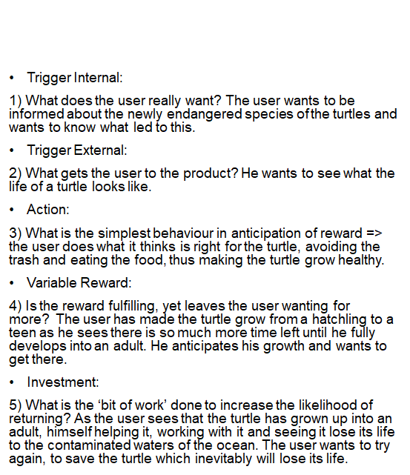
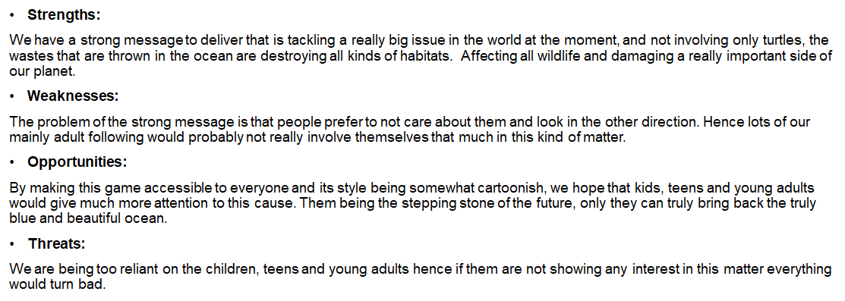
Research & Empathize
Hook Model
Swot Analysis

Slide 23
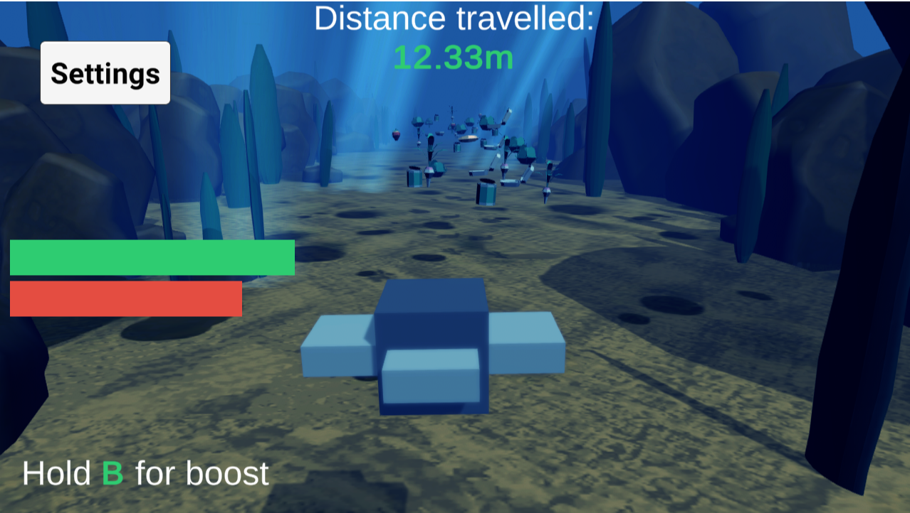
Design Process: Prototype & Test
There have been two surveys, to which we have about 6 answers each. The survey's asked about the feel of the game, mechanics, health & stamina. Speed & Speed boost etc.
1st Survey:
People mainly enjoyed the game and gave feedback upon the speed of which the game goes, how some of the mechanics do not work as intended. And gave us valuable insight regarding what is to be done in the future regarding our game.

Slide 24
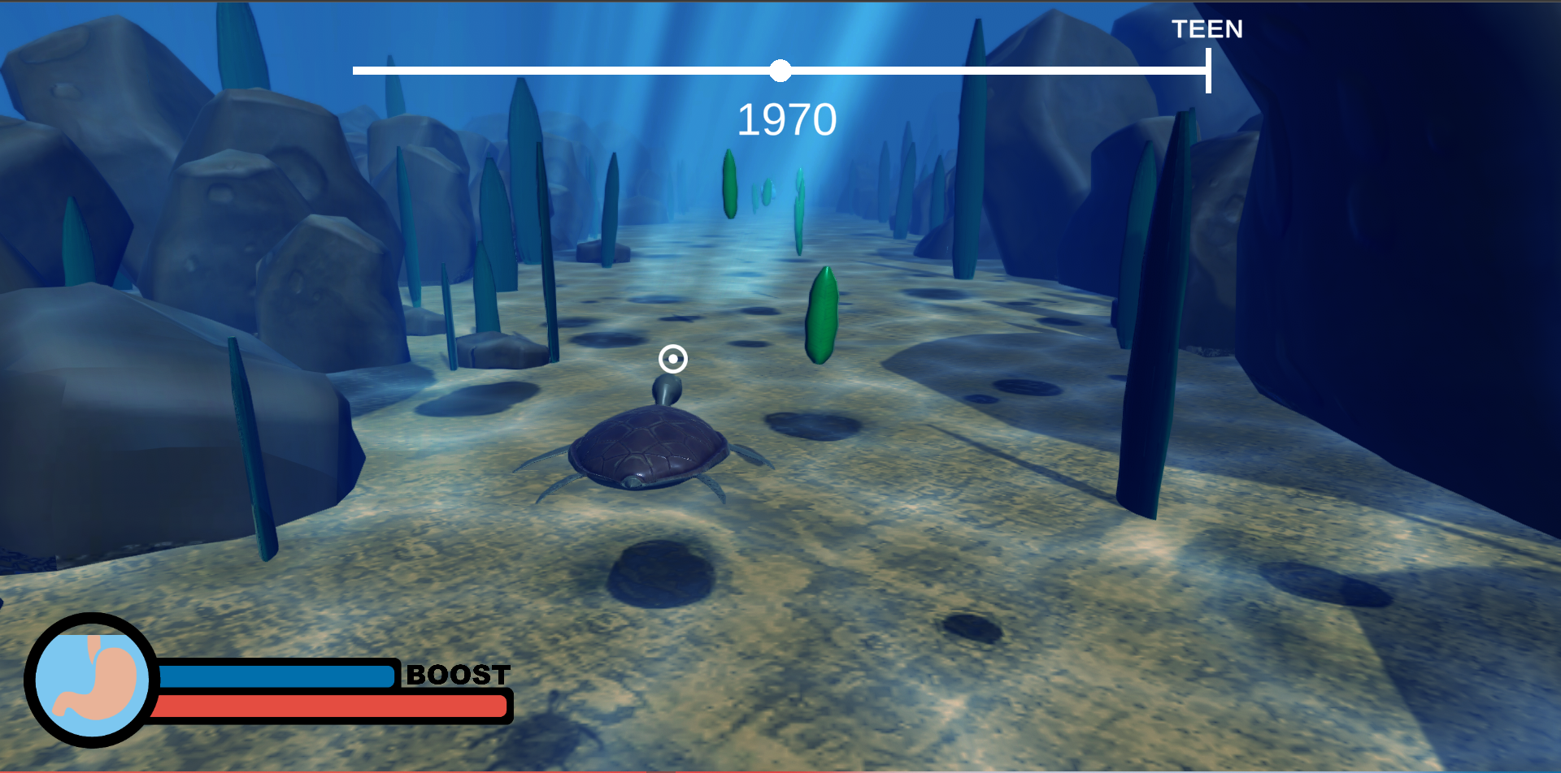
Design Process: Prototype & Test
2nd Survey:
Other 6 people tried out our mostly final version of the game and the feedback we have received impacted the fine tuning of the game and allowed us to give the player a more proper experience. There has been a clear increase in the enjoy factor of the game and replay ability became a thing.

Slide 25
Design Process: Prototype & Test
The method of quickly and easily changing the game, or how the fine tuning was done

Slide 26
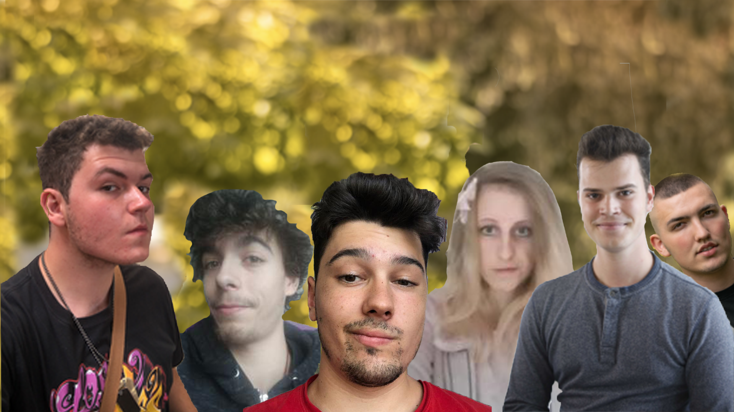
EAST COAST GANG

Slide 27
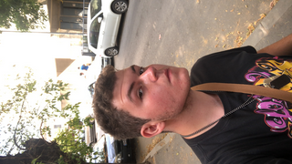
East Coast Gang: Rares
Designer
In charge of Documents and Presentation
I am managing Scrum.
Was in charge of storyboard writing.
Helped with feedback for the website.
Made the Game Surveys
REFLECTION:
Great team communication. I should probably learn how to make a proper burn out for the scrum board. Maybe change the workload so I do more stuff.

Slide 28
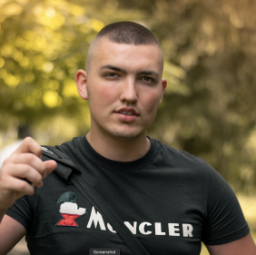
East Coast Gang: Mert
Designer
Finished Website
Finished Trailer
Finished Sounds
REFLECTION
Should improve on being in time
Good motivator
On time on tasks

Slide 29
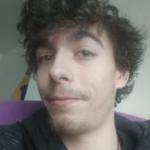
East Coast Gang: Vlad
Engineer
In charge of UI/UX features.
Turtle naming features, leaderboard implementation
Worked together with Teodor on background
REFLECTION:
Great communication, especially with the other engineer
Everyone always knew their tasks

Slide 30
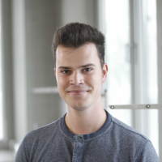
East Coast Gang: Teodor
Engineer
In charge of main game mechanics
Some UI implementation
Made the look & feel of the ocean using shaders, post processing
R E F L E C T I O N
Great team communication Amazing learning experience Great collaboration with the other engineer

Slide 31
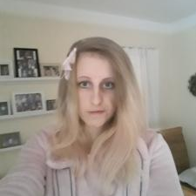
East Coast Gang: Julia
Artist
UI/UX prerequisites
Storyboard
In game Assets (Buttons, Icons, Farting Turtle)
Title screen Logo
Trailer Art
R E F L E C T I O N
Great teamwork + independent work, Good team leader, understanding teammates, I need to be more vocal

Slide 32
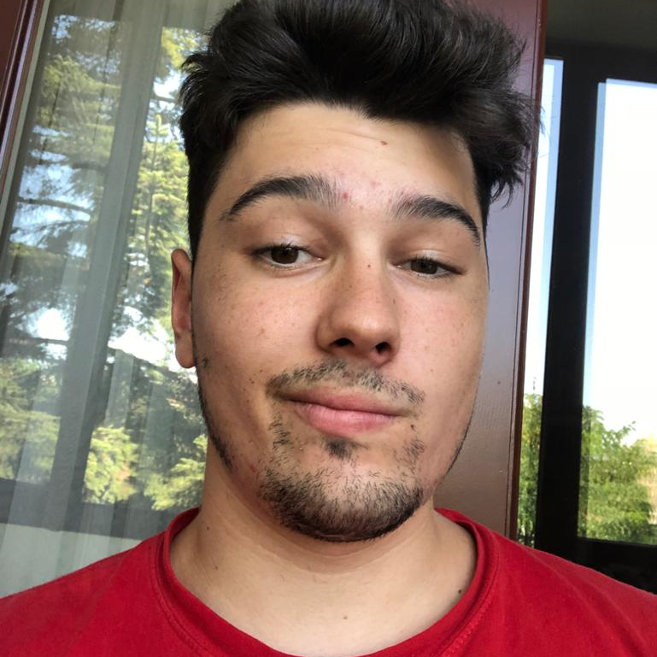
East Coast Gang: Tudor
.
Artist:
3d Models for all the assets.
UV Maps for assets.
Texturing.
Creating High Poly.
Rigging.
Animating.
Reflection:
Good team communication.
Good workflow between artists and engineers.

